Slide 1
What’s in my tube? Why viral taxonomy matters.
J. Rodney Brister – Chief, NCBI Virus Resources

Slide 2
What’s in My Tube?
Extant sequence space is a collection of relatively few known sequences distributed among a dense background of unknown sequences.

Slide 3
What’s in My Tube?
BAG
OF SEQ
DATA
Have a sequence and want to know what it is.
Compare to extant sequence space.

Slide 4
What’s in My Tube?
BAG
OF SEQ
DATA
If sequence matches known virus, then attributes can be inferred.
If sequence does not match known, then what?

Slide 5
What’s in My Tube?
How to organize sequence space into groups with shared attributes?
How to support inference of attributes.

Slide 6
What is Taxonomy?
Taxonomy is the science of defining and naming groups of biological organisms on the basis of shared characteristics.
Organisms are grouped together into taxa and these groups are given a taxonomic rank; groups of a given rank can be aggregated to form a super-group of higher rank, thus creating a taxonomic hierarchy.
*Wikipedia contributors. "Taxonomy (biology)." Wikipedia, The Free Encyclopedia. Wikipedia, The Free Encyclopedia, 26 Apr. 2018. Web. 26 Apr. 2018..

Slide 7
What is Taxonomy?
Taxonomy provides synthetic groups defined by shared attributes.
Members are real entities and are assigned group based on individual attributes.

Slide 8
What is Taxonomy?
Groups can be represented by individual member(s), i.e. type isolates or references.
Polythetic classes so no one single member may have all attributes of the group.

Slide 9
What is Taxonomy?
Taxonomy provides hierarchy of taxonomic relationships.
Each node in the hierarchy is defined by a set of attributes shared by lower nodes.

Slide 10
Viral Taxonomy and the ICTV
Taxonomy for viruses currently assigned by the International Committee for the Taxonomy of Viruses (ICTV).
“To this end, the Virology Division of the International Union of Microbiological Societies (IUMS) charged the International Committee on Taxonomy of Viruses (ICTV) with the task of developing, refining, and maintaining a universal virus taxonomy. The goal of this undertaking is to categorize the multitude of known viruses into a single classification scheme that reflects their evolutionary relationships, i.e. their individual phylogenies.”
ICTV Online (10th) Report (2017)

Slide 11
Viral Taxonomy and the ICTV
The lowest taxonomic rank is that of species, which is defined [by the ICTV] as “a monophyletic group of viruses whose properties can be distinguished from those of other species by multiple criteria.”
Historically, the term “multiple criteria” has been interpreted as referring to attributes such as replication properties in cell culture, virion morphology, serology, nucleic acid sequence, host range, pathogenicity, and epidemiology or epizootiology.
There is considerable variation in the way in which [species] criteria have been applied to viruses in different families by the respective Study Groups and approved by the ICTV.
Simmonds P, et al. Consensus statement: Virus taxonomy in the age of metagenomics. Nature Reviews Microbiology. 2017 Mar;15(3):161-168.

Slide 12
Viral Taxonomy and the ICTV
The hierarchy of recognized viral taxa is therefore:
(Order)
Family
(Sub-family)
Genus
Species
Only the aforementioned taxa are recognized by the ICTV. Other groupings (from clade to super-family), may communicate useful descriptive information in some circumstances but they have no formally recognized taxonomic meaning. Similarly, the term “quasi-species”, although it captures an important concept, has no recognized taxonomic meaning.
ICTV Online (10th) Report (2017)

Slide 13
How Does Taxonomy Help Indentification?
BAG
OF SEQ
DATA
If sequence does not match known virus, then attributes can still be inferred from higher order taxonomic relationships.

Slide 14
Viral Taxonomy – Why Do I Care?

Slide 15
NCBI Virus – RefSeq and Genomes
Non-redundant references (landmarks) that
support identification.
Provide well annotation references.
Olga Blinkova
Ryan Connor
Eneida Hatcher
Igor Tolstoy

Slide 16

NCBI Virus – RefSeq and Genomes
Genome selection
Scan GenBank
for new sequences

Slide 17
NCBI Virus – RefSeq and Genomes
Genome selection
International Committee
on Taxonomy of Viruses
(ICTV)
Taxonomy validation

Slide 18
NCBI Virus – RefSeq and Genomes
Archival viral species
NCBI viral species
ICTV species
*Values were calculated on December 31 of each year.

Slide 19
NCBI Virus – RefSeq and Genomes
Genome selection
Taxonomy validation
Reference creation
Neighbor indexing

Slide 20
NCBI Virus – RefSeq and Genomes
GenBank sequences
Validated sequences
RefSeq sequences
*Values were calculated on December 31 of each year.

Slide 21
Viral Taxonomy – Some in House Experiments

Slide 22
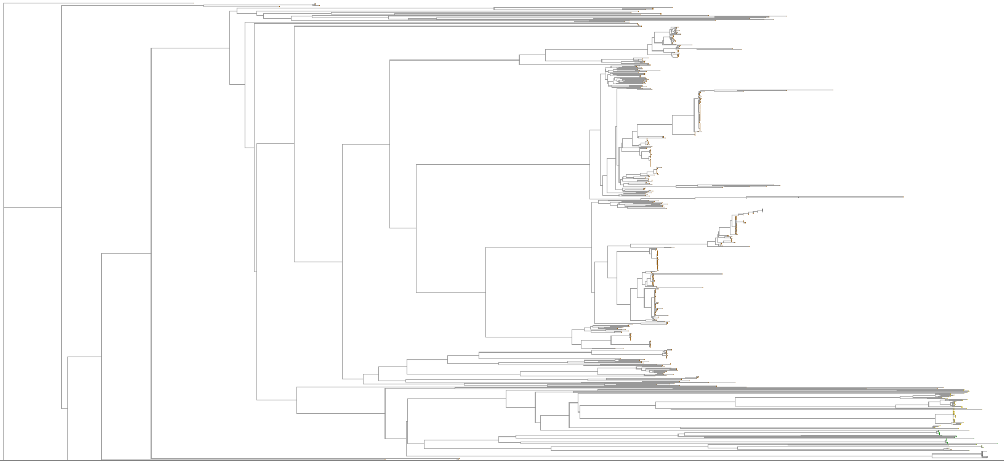
Average Nucleotide Identity
Family Adenoviridae
Igor Tolstoy

Slide 23
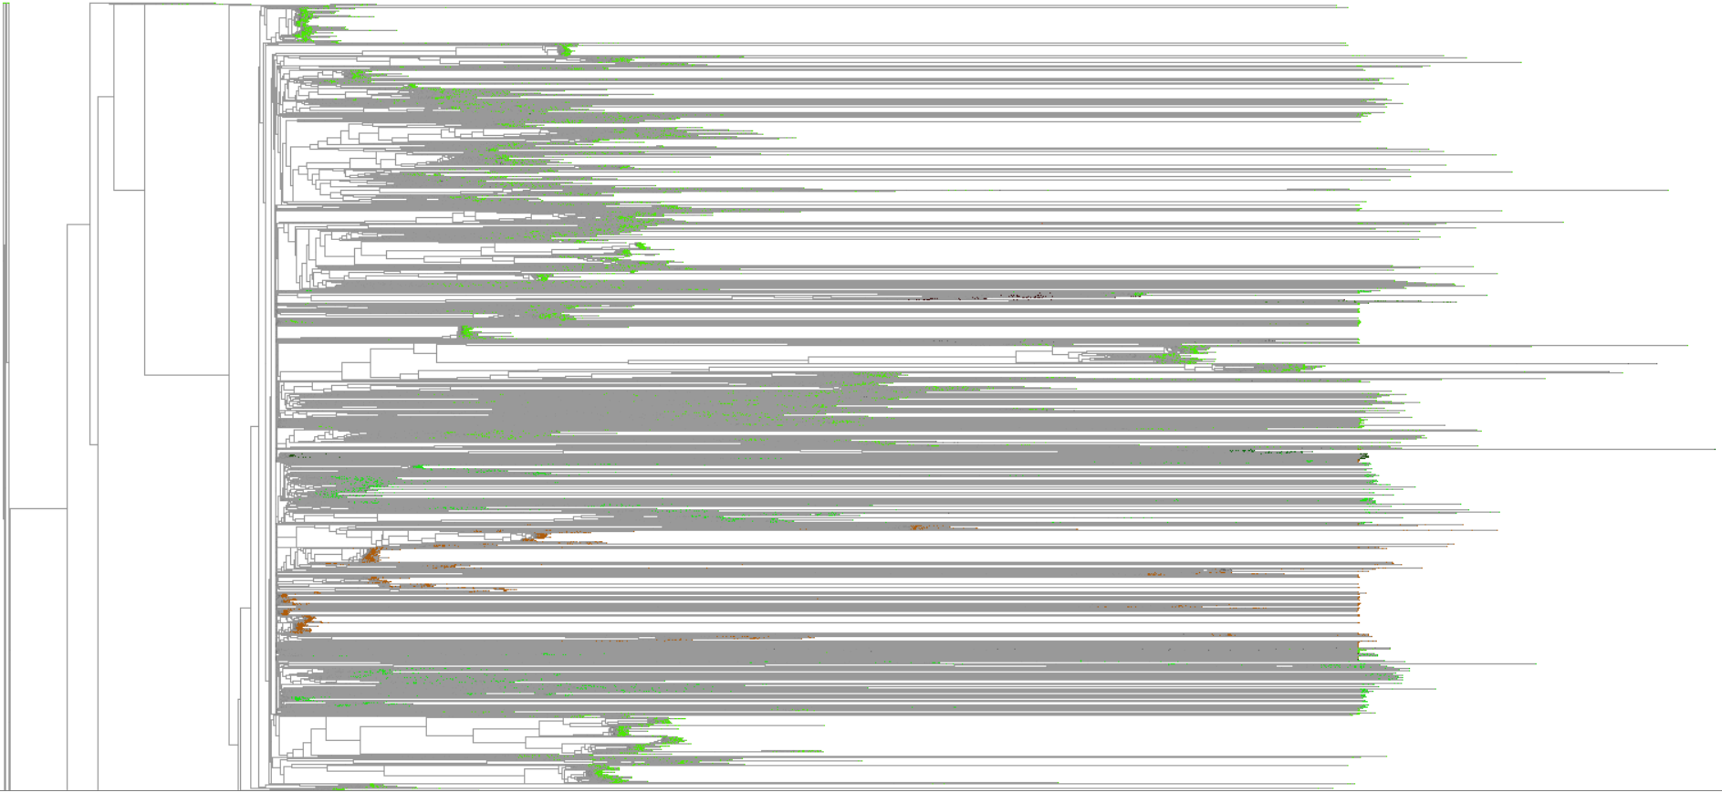
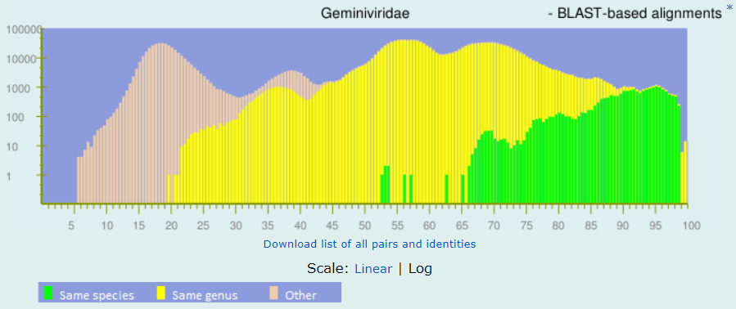
Average Nucleotide Identity
Family Geminiviridae
Igor Tolstoy

Slide 24

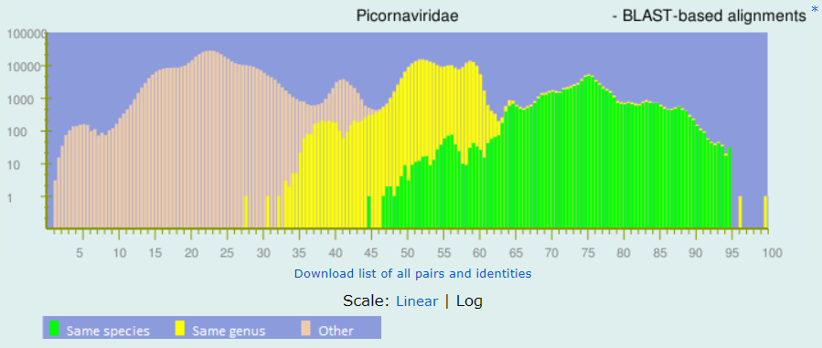
Average Nucleotide Identity
Family Picornaviridae
Igor Tolstoy

Slide 25
Viral Taxonomy – Some in House Experiments
Nucleotide based approaches have limitations.
Not a guarantee of consistent metrics.
Need significant identity/coverage.
Better suited for species level grouping.
Need additional approaches for higher level taxa grouping.

Slide 26
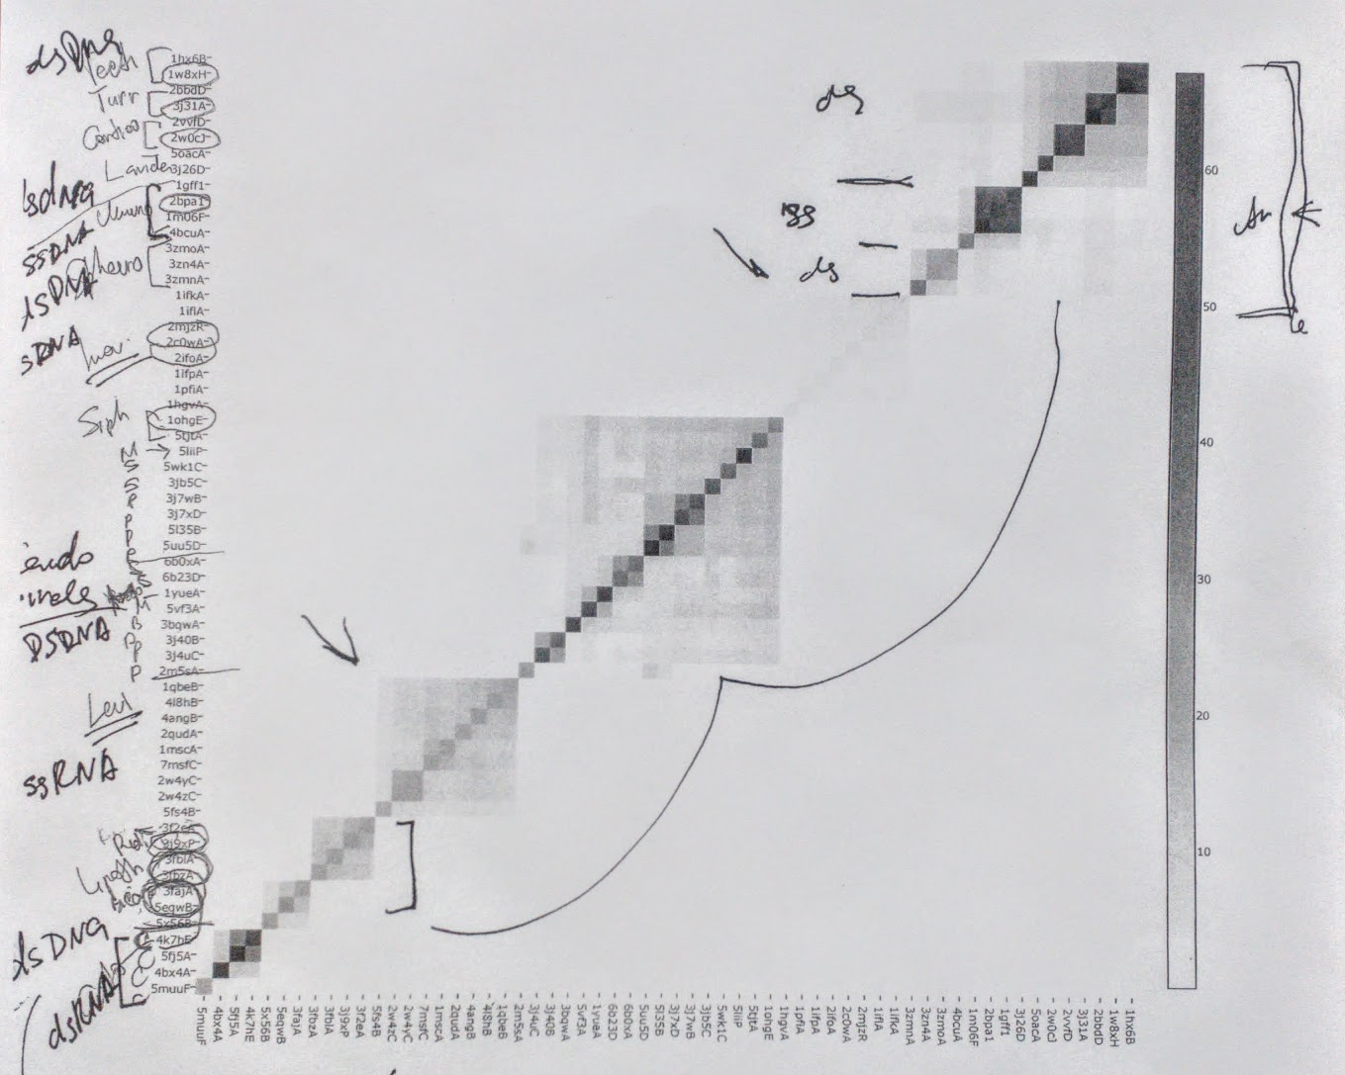
Major Capsid Protein Taxonomic Distribution
Similarity matrix of bacteriophage major capsid protein models from Protein Data Bank.
Models mapped to bacteriophage groups.
Model grouping roughly equivalent to genera.
Multiple clusters of dsDNA MCPs.
Igor Tolstoy

Slide 27
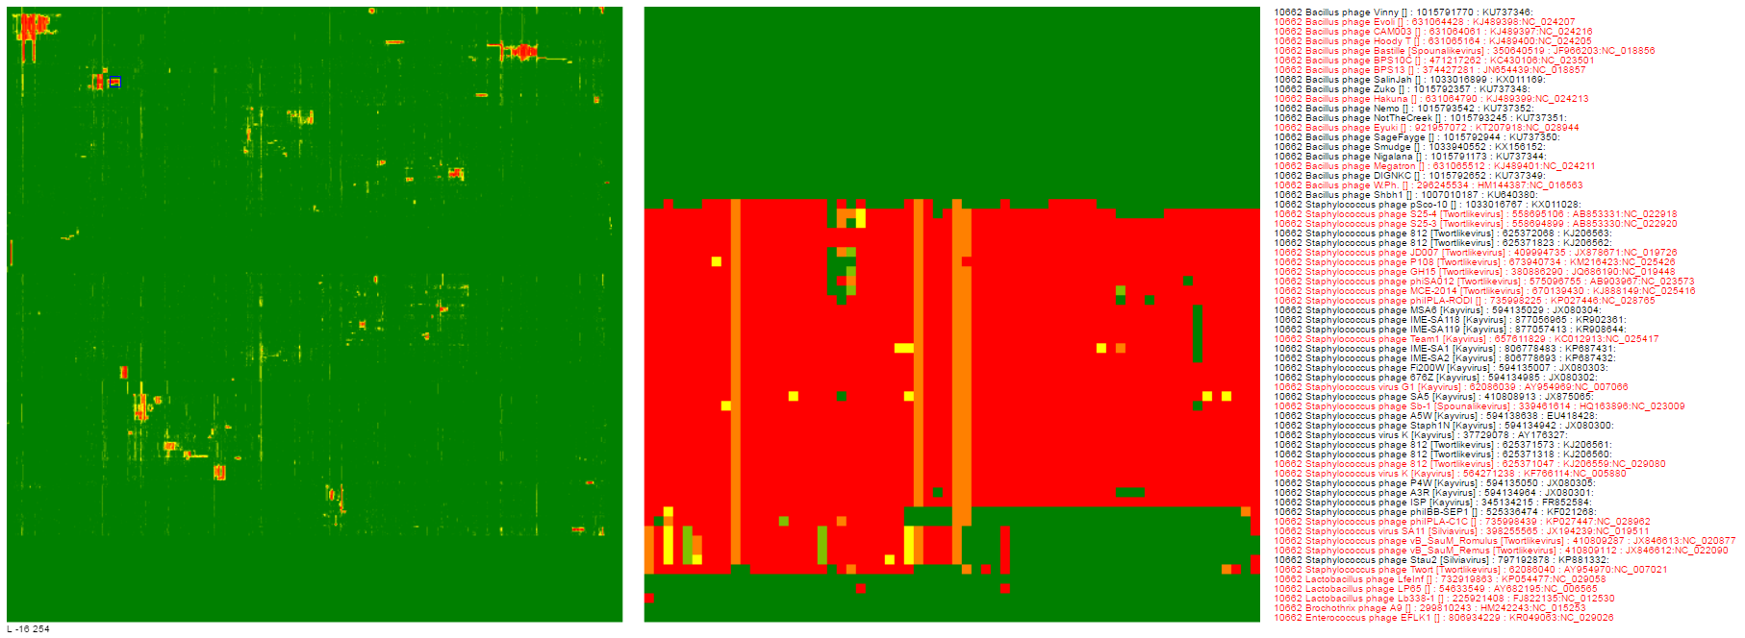

Genome Clusters Revealed by PSSMs
X-axis is PSSM gene models
Y-axis is bacteriophage genomes
Igor Tolstoy

Slide 28
Binary Approaches to Taxonomy
CD₁
CD₂
CD₃
GENOME 1
GENOME 2
GENOME 3
GENOME 4
GENOME 5
GENE 1
GENE 2
GENE 2
Align genomes within group and calculate conserved domains (CDs), HMMs, PSSMs, etc.
Repeat process for all groups

Slide 29
Binary Approaches to Taxonomy
CD₁
CD₂
CD₄
CD₁
CD₂
CD₃
Define each group by conserved domains (CDs)
Construct binary tree based on presence or absence of conserved domains (CDs)
CD₁
CD₂
CD₅

Slide 30
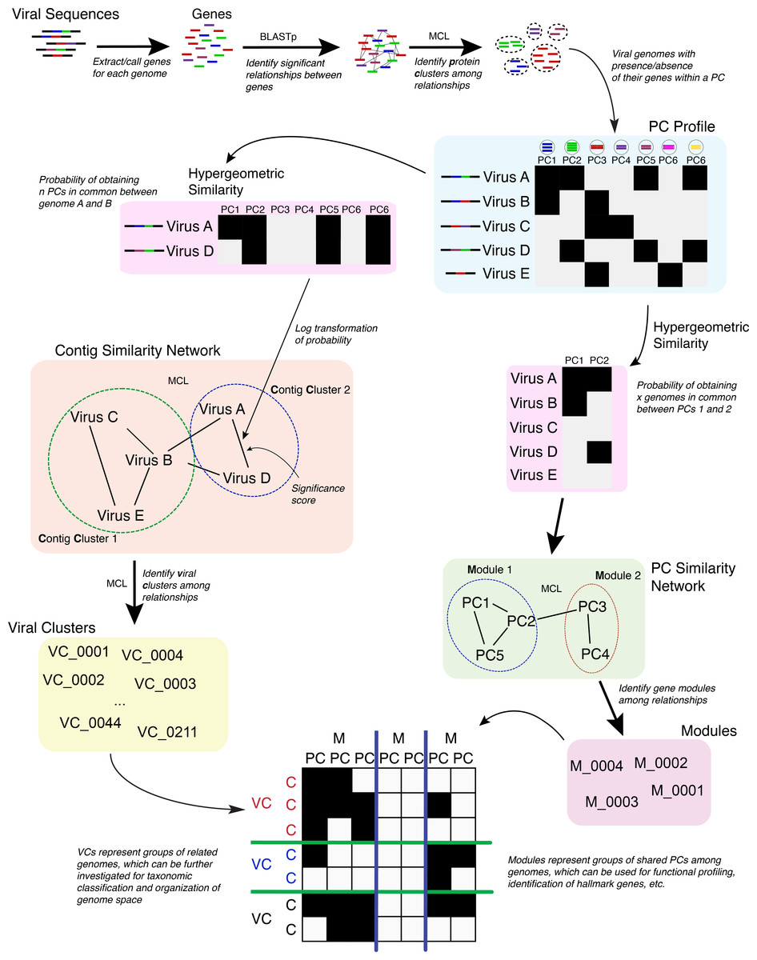
Network Analysis of Genomes
vConTACT analyses are based on previously established gene sharing network methods (Lima-Mendez et al., 2008). Briefly, protein clusters (PCs) are established across all genomes in the dataset; with vConTACT doing this by default using Markov clustering from all-versus-all BLASTP comparisons (though user-specified clusters can also be used). PC profiles of genomes or genome fragments (herein ‘genome’) are then calculated, where the presence and absence of PCs (from the entire PC dataset) along a genome are established and then compared pairwise between genomes.
Bolduc, B, et al. vConTACT: an iVirus tool to classify double-stranded DNA viruses that infect Archaea and Bacteria. Nature Reviews Microbiology. 2017 PeerJ 5:e3243.

Slide 31
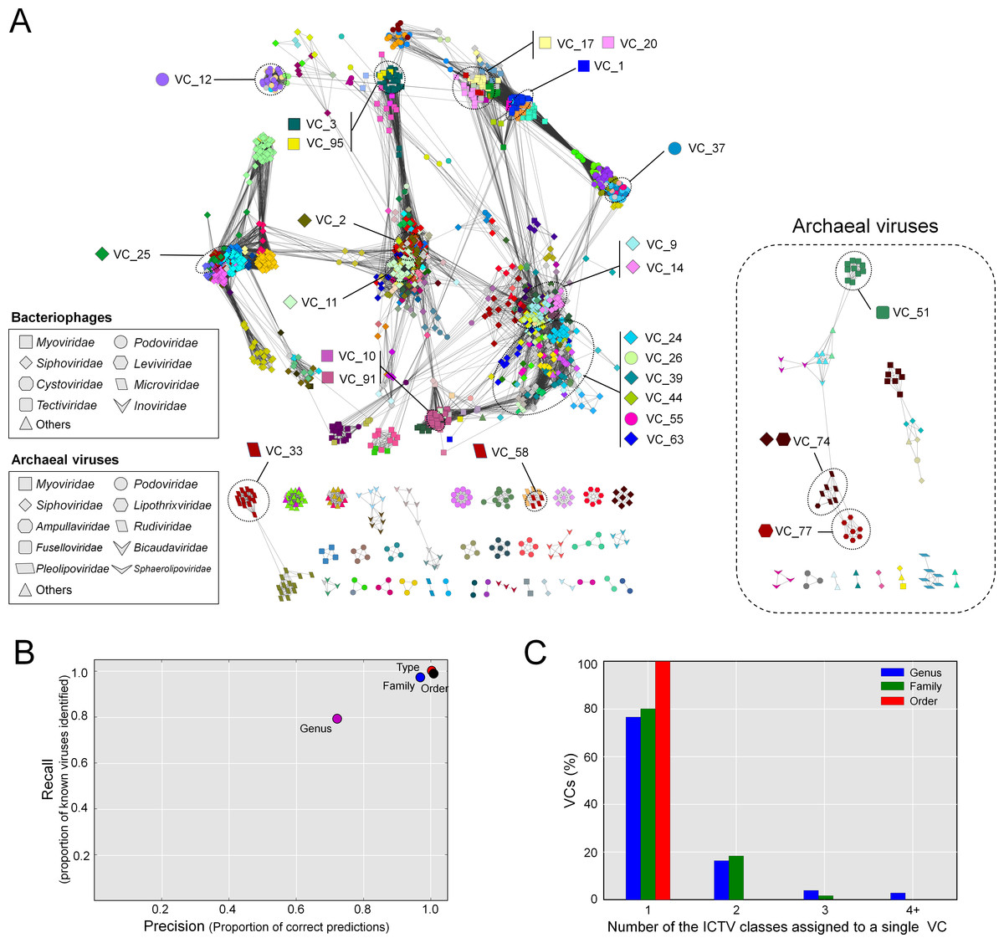
Network Analysis of Genomes
vConTACT viral clusters (VCs)
Analyses underscore two issues:
(1) Current ICTV bacteriophage taxonomy needs to be better sorted to support bench marching.
(2) Need publicly available, community accepted protein cluster, HMM, and/or PSSM resources.
Bolduc, B, et al. vConTACT: an iVirus tool to classify double-stranded DNA viruses that infect Archaea and Bacteria. Nature Reviews Microbiology. 2017 PeerJ 5:e3243.

Slide 32
Viral Taxonomy – Not Only About Assemblies

Slide 33
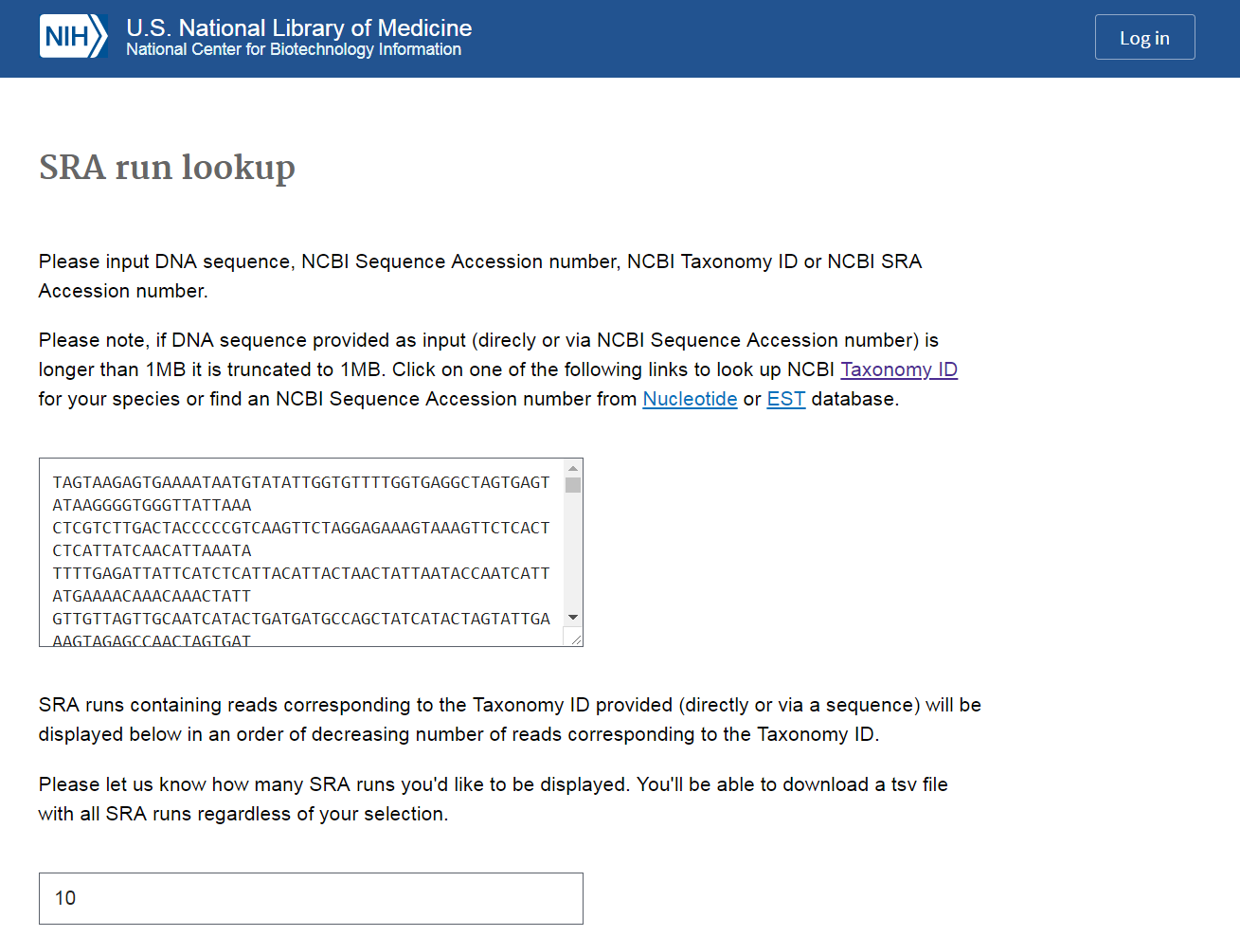
SRA Taxonomy Analysis Tool
SRA Taxonomy Analysis Toll (STAT)
K-mer index from reference genomes
Non-informative k-mers removed
Shared k-mers mapper to taxonomy hierarchy

Slide 34
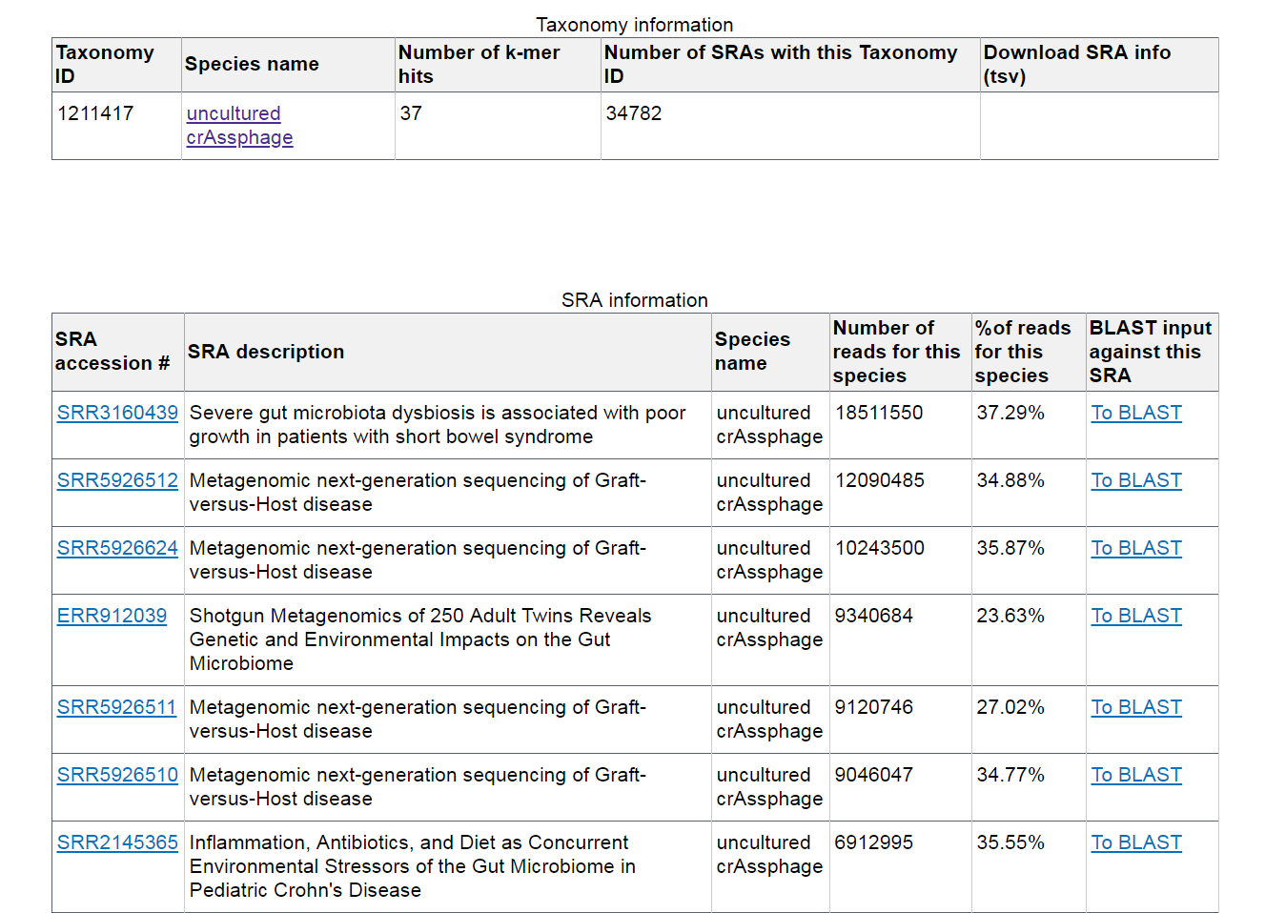
SRA Taxonomy Analysis Tool
STAT currently used to support SRA experiment search based on taxonomy assignment of reads.

Slide 35
Thank you
This research was supported by the Intramural Research Program of the National Institutes of Health, National Library of Medicine.
Olga Blinkova
Ryan Connor
Eneida Hatcher
Igor Tolstoy
Oleg Shutov
Chris O’Sullivan
Ilene Mizrachi
Valerie Schneider
Steve Sherry
Kim Pruitt
Jim Ostell

